Slide 1
Phone Finder Supervised by Dr. Amr Badr Dr.Eman Hossny
Graduation Project
Academic Year 2019-2020
Notes:
Font was 60

Slide 2
Team !
ID | Name
20160086 | Gomaa Abied Mohamed
20160060 | Alaa EL-Menshawy Abd-EL-Fatah
20160146 | Ezz EL-dein Asaad Saad
20160170 | Amr Mohamed Fahmy

Slide 3
Agenda
Introduction and Background
Motivation
Problem definition
Objectives
Challenges
System architecture
Project specifications
Conclusion
Demo

Slide 4

Introduction & Background
- Intelligent assistant produces mobile community among mobile users and store owners.
- We use Machine Learning :
- K Nearest Neighbor Algorithm.
- Cosine Similarity - We use Deep Learning :
- Convolutional Neural Network (CNN).

Slide 5







Motivation
User can’t find mobile with specific features or can’t predict its price.

Slide 6
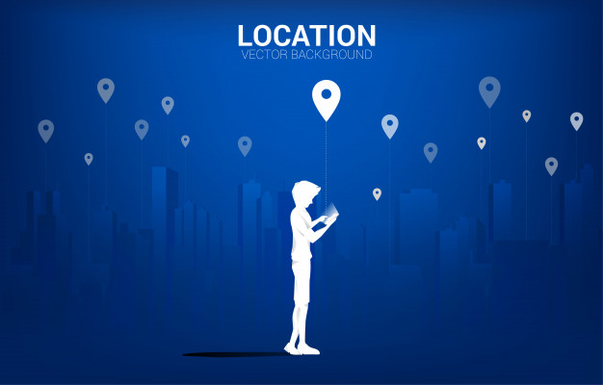
Motivation
User can’t find mobile stores with specific distance and rate.

Slide 7

Motivation
Store owner thinks how to communicate with more users to increase his income.

Slide 8



Problem Definition
Can’t find a trusted mobile store to deal with.

Slide 9

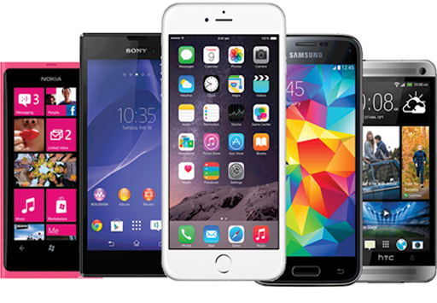


Problem Definition
Store owner can’t mount his mobiles.

Slide 10






Problem Definition
Store owner can’t find a way to make his online advertisements.
Notes:
Normal person
Think to steal

Slide 11
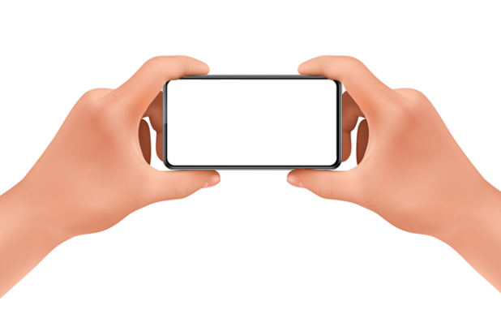
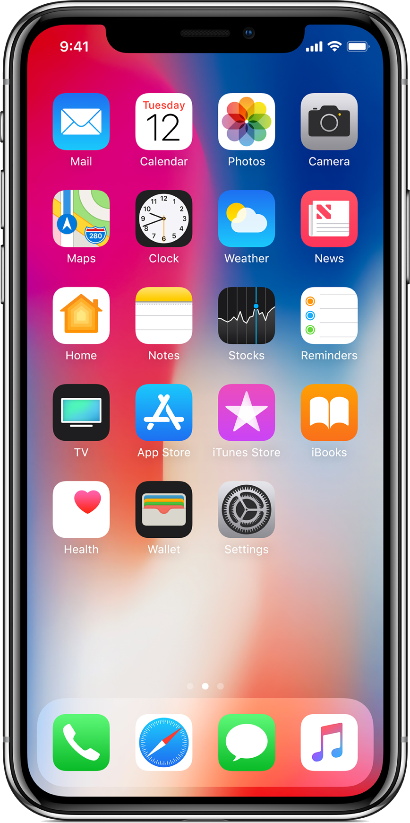
Problem Definition
User can’t know the mobile features from its appearance.

Slide 12
Objectives
1
Phone Recognizer
2
Software Community
Building Deep Learning(DL) Model to Recognize the mobile brand and name.
Developing Software Community to communicate between Mobile Stores and users.
3
Recommendation System
Designing Machine Learning(ML) model to recommend The best Store and mobile according to User Preferences.

Slide 13
Challenges
Adding new mobile
Recommend with more features
To let model recognize new mobile you should collect enough dataset
In our dataset you can recommend mobiles only using size and battery.
Video performance
To analyze large video may take several time according to server performance

Slide 14










System Architecture
Machine Learning
Return recommended data
Access REST API
Send data
Return info
Return location
Send data
Access Google maps API
Access DB
Return predicted data
Return mobile features info
Mobile name
Deep Learning

Slide 15

K Nearest Neighbor (KNN - ML)

Slide 16
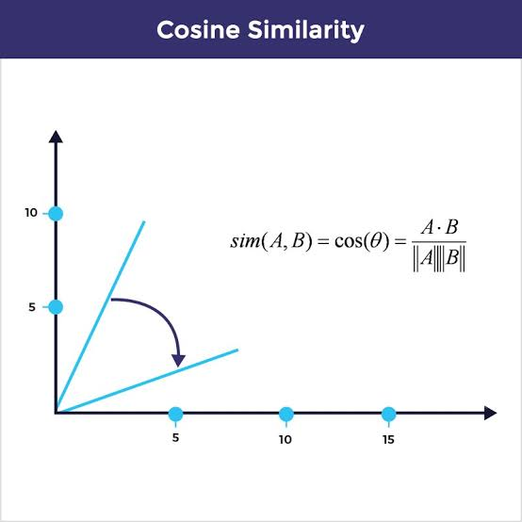

Cosine Similarity (ML)
RAM :8G
Selfi-Camera: 5 MP
Main-Camera: 13Mp
Battery: 3000MA

Slide 17
Logistic Regression
$ $ $ $ $$$$$ $$$$$
$$$$ $$$$
$$$
$$$
$$$

Slide 18

Convolutional Neural Network (CNN - DL)

Slide 19
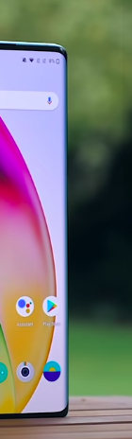
Cropping video for Image classification

Slide 20
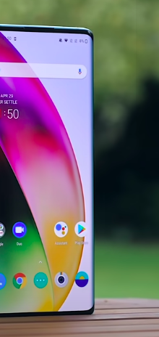
Cropping video for Image classification

Slide 21
Cropping video for Image classification

Slide 22
Cropping video for Image classification

Slide 23
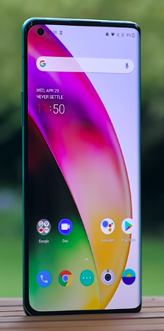
Cropping video for Image classification

Slide 24
Cropping video for Image classification

Slide 25
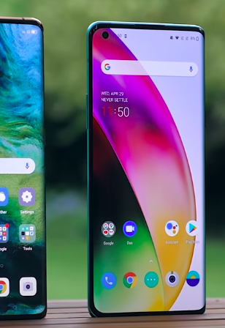
Cropping video for Image classification

Slide 26
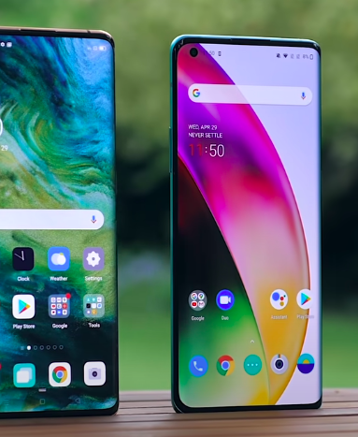
Cropping video for Image classification

Slide 27
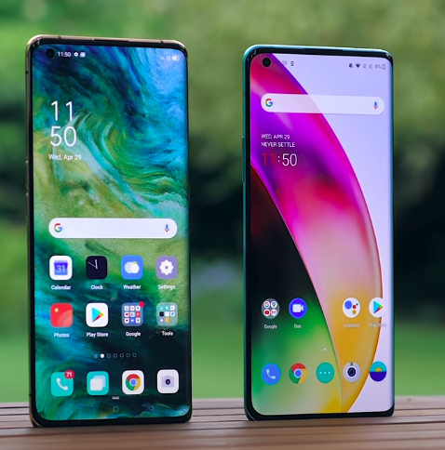
Cropping video for Image classification

Slide 28
Cropping video for Image classification

Slide 29
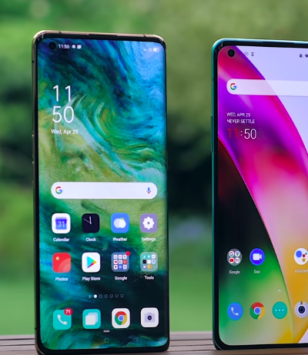
Cropping video for Image classification

Slide 30
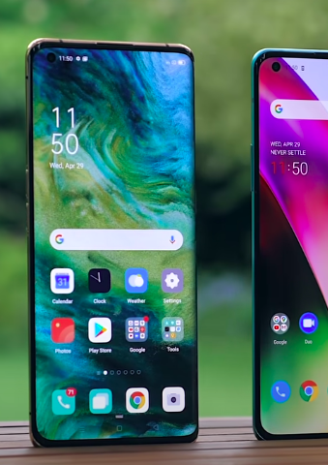
Cropping video for Image classification

Slide 31
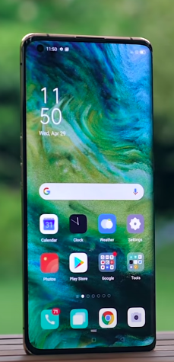
Cropping video for Image classification

Slide 32
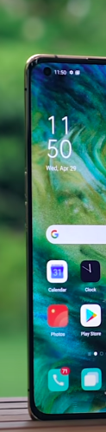
Cropping video for Image classification

Slide 33

Cropping video for Image classification

Slide 34
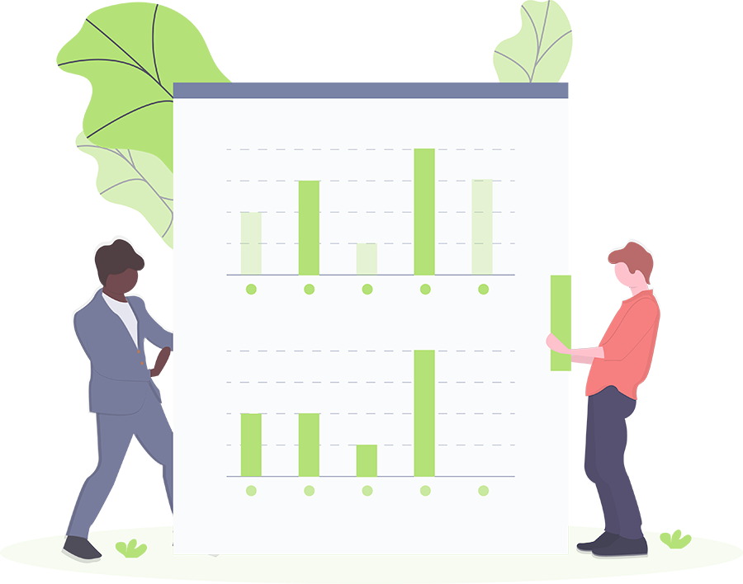
Project specifications :
Use case Diagram
Class Diagram
Component Diagram
Sequence Diagram :Photo Analyzer
Sequence Diagram :Video Analyzer
Sequence Diagram :Mobiles Recommendation
Sequence Diagram :Stores Recommendation
ERD

Slide 35
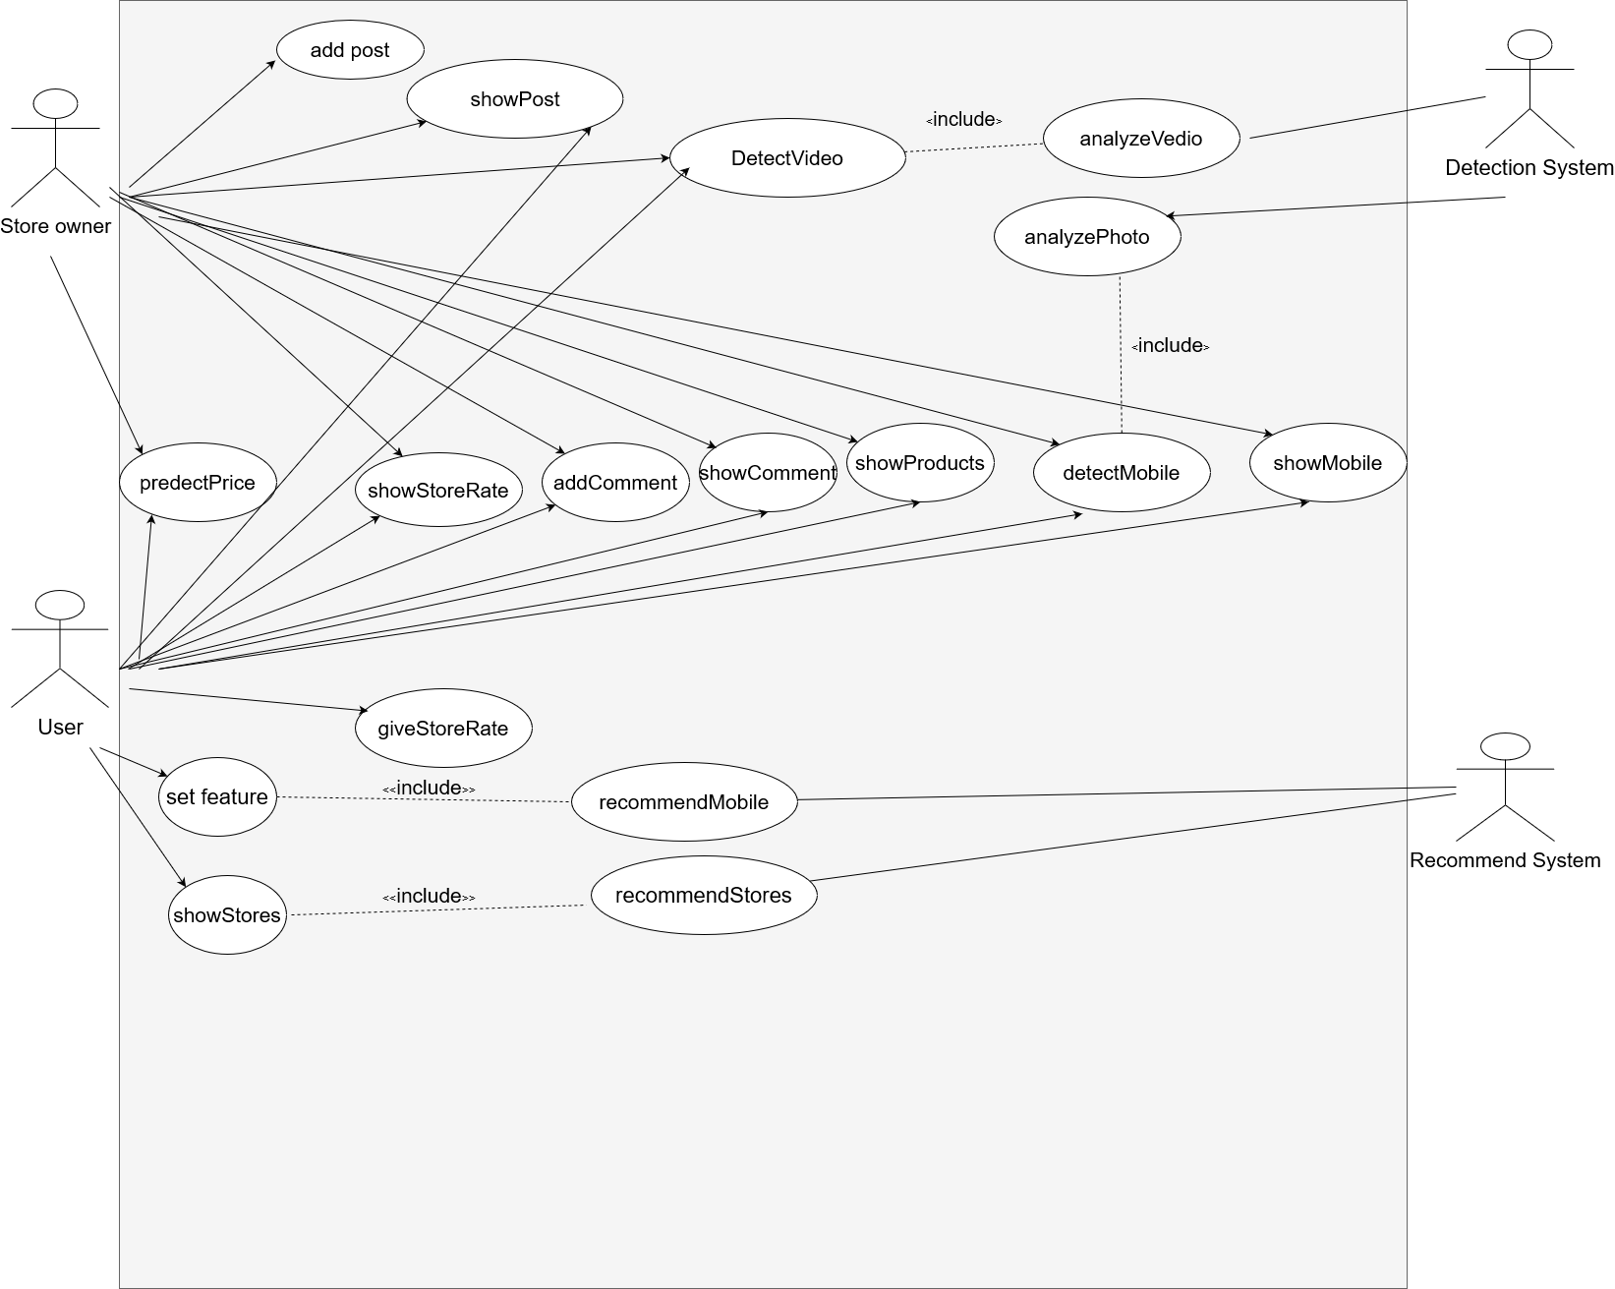
Use case Diagram

Slide 36
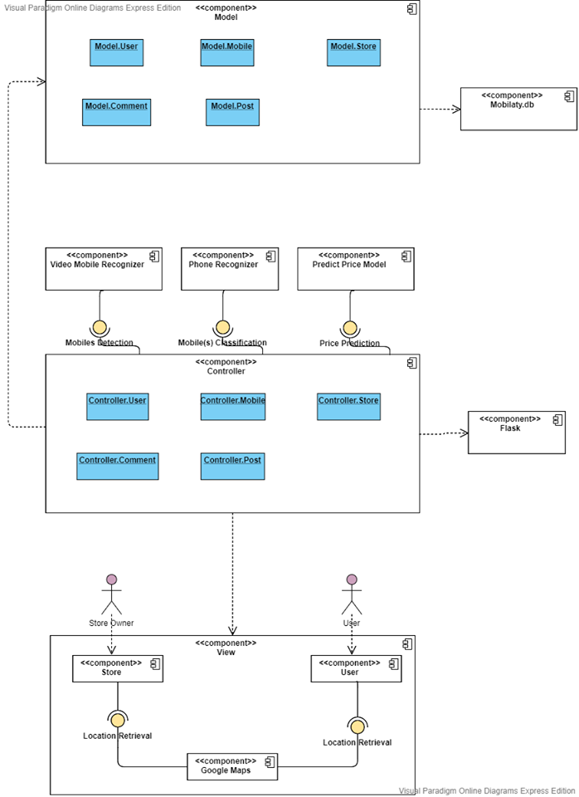
Component Diagram

Slide 37
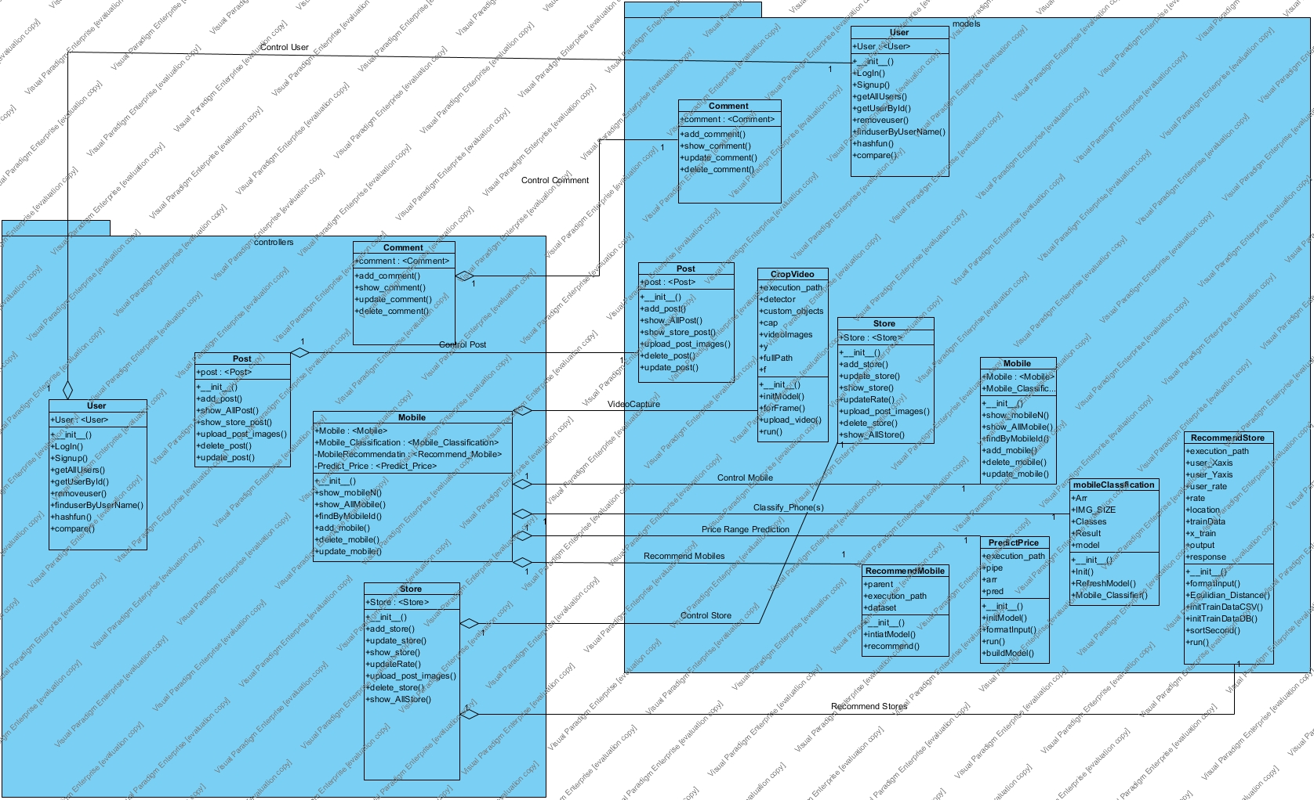
Class Diagram

Slide 38
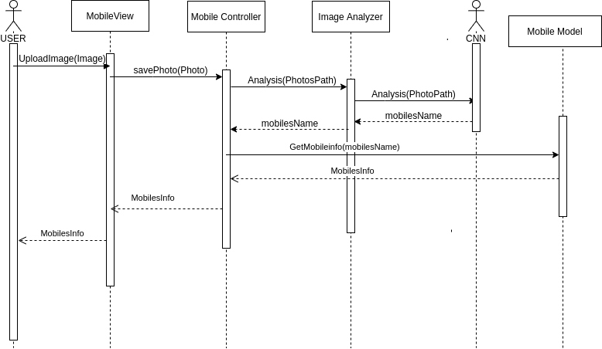
Sequence Diagram :Photo analyzer

Slide 39
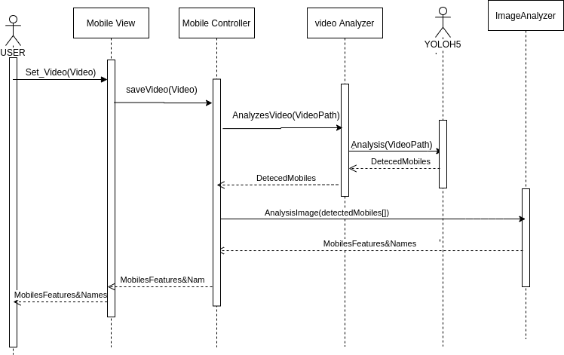
Sequence Diagram :Video analyzer

Slide 40
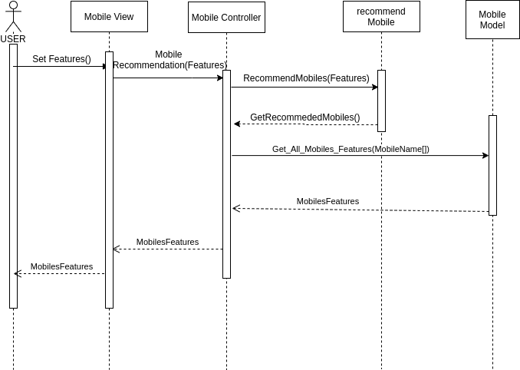
Sequence Diagram : Mobiles Recommendation

Slide 41
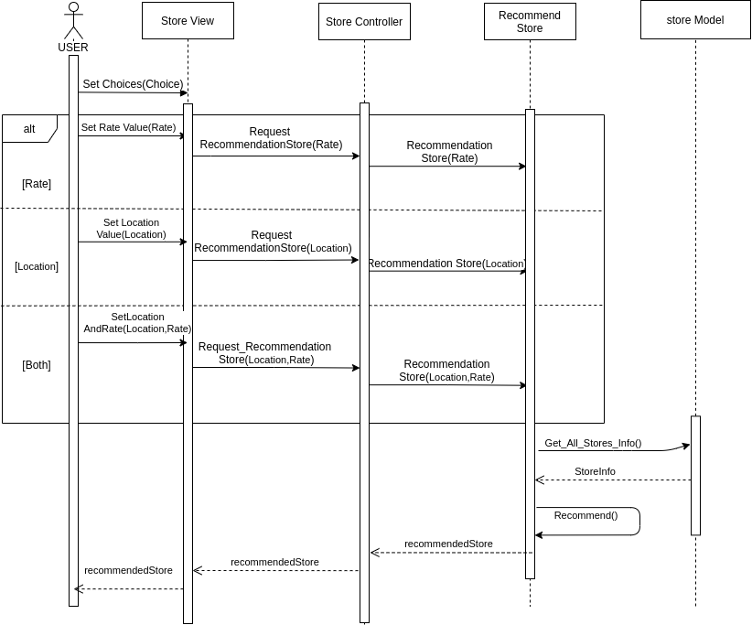
Sequence Diagram : Stores Recommendation

Slide 42
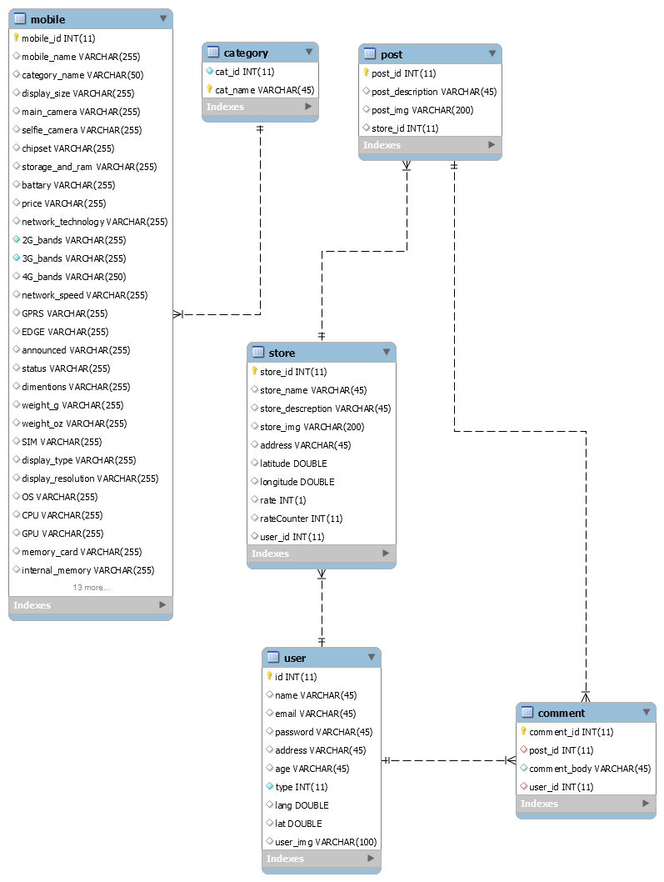
ERD

Slide 43
Conclusion
Finally we wish to build safe community among shops
to trust user the store which deal with.
Facilitating in recommending mobile to user by some features.
Guiding users to get their prefer mobile.

Slide 44
Thanks!
Any questions?

